Slide 1
Inverted File Organization and Indexing Model
Reference:
James Allan, University of Massachusetts Amherst
Gerald Benoit, Simmons College
Pandu Nayak and Prabhakar Raghavan，Stanford University
Edt. By: Qingcai Chen, HITSZ

Slide 2
Some vocabulary
File organizations or indexes are used to increase performance of system
Will talk about how to store indexes later
Text indexing is the process of deciding what will be used to represent a given document
These index terms are then used to build indexes for the documents
The retrieval model described how the indexed terms are incorporated into a model
Relationship between retrieval model and indexing model

Slide 3
Content
Brief Review of Vector Space Model
Inverted Files
Index Models (Feature Selection)

Slide 4
Results of a Search
x
x
hits from search
x
Δ
x
x
x
x
x documents found by search
Δ query

Slide 5
Use of Inverted Files for Calculating Similarities
In the term vector space, if q is query and d_{j} a document,
then q and d_{j} have no terms in common iff q.d_{j} = 0, so we don’t need to waste resource on these documents.
1. To calculate all the non-zero similarities, find all the documents, d_{j}, that contain at least one term in the query:
Merge the inverted lists for each term t_{i} in the query, with a logical OR, to establish a set of hits, R.
For each d_{j} ∈ R, calculate Similarity(q, d_{j}), using appropriate weights.
2. Return the elements of R in ranked order.
Notes:
Here we will discuss the implementation for supporting previous and other tasks.

Slide 6
Content
Brief Review of Vector Space Model
Inverted Files
Index Models (Feature Selection)
Notes:
Ask students to design a file organization model before going ahead.

Slide 7
Representation of Inverted Files
Document file: Stores the documents. Important for user interface design.
Index (word list, vocabulary) file: Stores list of terms (keywords). Designed for searching and sequential processing, e.g., for range queries, (lexicographic index). Often held in memory.
Postings file: Stores an inverted list (postings list) of postings for each term. Designed for rapid merging of lists and calculation of similarities. Each list is usually stored sequentially.
Notes:
Why we need Inverted files? What’s the relationship of inverted files and VSM?

Slide 8
Organization of Inverted Files
Index file
Postings file
Documents file
Term Pointer to
postings
ant
bee
cat
dog
elk
fox
gnu
hog
Inverted lists

Slide 9





The basic indexing pipeline
Documents to
be indexed.
Friends, Romans, countrymen.
Tokenizer
Token stream.
Friends
Romans
Countrymen
Linguistic modules
Modified tokens.
friend
roman
countryman
Indexer
friend
2
4
roman
1
2
Inverted index.
countryman
13
16

Slide 10
Parsing a document
Sec. 2.1
What format is it in?
pdf/word/excel/html?
What language is it in?
What character set is in use?
Each of these is a classification problem.
But these tasks are often done heuristically …

Slide 11
Decisions in Building Inverted Files: What is a Term?
Underlying character set, e.g., printable ASCII,
Unicode, UTF8.
Is there a controlled vocabulary? If so, what
words are included?
List of stopwords. “的、因为、所以…..”
Rules to decide the beginning and end of words, e.g.,
spaces or punctuation. “长长长长长，行行行行行”
Character sequences not to be indexed, e.g.,
sequences of numbers. “12345, 2603, 3475?”
What’s the differences between Chinese and English?

Slide 12
TOKENS AND TERMS
12

Slide 13
Tokenization(断词,标记化)
Input: “Friends, Romans, Countrymen”
Output: Tokens
Friends
Romans
Countrymen
A token is a sequence of characters in a document
Each such token is now a candidate for an index entry, after further processing
Described below
But what are valid tokens to emit?

Slide 14
Tokenization
Issues in tokenization:
Finland’s capital →
Finland? Finlands? Finland’s?
Hewlett-Packard → Hewlett and Packard as two tokens?
state-of-the-art: break up hyphenated sequence.
co-education
lowercase, lower-case, lower case ?
It can be effective to get the user to put in possible hyphens
San Francisco: one token or two?
How do you decide it is one token?

Slide 15
Numbers
3/12/91 Mar. 12, 1991 12/3/91
55 B.C.
B-52
My PGP key is 324a3df234cb23e
(800) 234-2333
Often have embedded spaces
Older IR systems may not index numbers
But often very useful: think about things like looking up error codes/stacktraces on the web
Will often index “meta-data” separately
Creation date, format, etc.

Slide 16
Tokenization: language issues
French
L'ensemble → one token or two?
L ? L’ ? Le ?
Want l’ensemble to match with un ensemble
Until at least 2003, it didn’t on Google
Internationalization!
German noun compounds are not segmented
Lebensversicherungsgesellschaftsangestellter
‘life insurance company employee’
German retrieval systems benefit greatly from a compound splitter module
Can give a 15% performance boost for German

Slide 17
Tokenization: language issues
Chinese and Japanese have no spaces between words:
莎拉波娃现在居住在美国东南部的佛罗里达。
Not always guaranteed a unique tokenization
Further complicated in Japanese, with multiple alphabets intermingled
Dates/amounts in multiple formats
フォーチュン500社は情報不足のため時間あた$500K(約6,000万円)
Katakana
Hiragana
Kanji
Romaji
End-user can express query entirely in hiragana(平假名）

Slide 18
Tokenization: language issues
Arabic (or Hebrew) is basically written right to left, but with certain items like numbers written left to right
Words are separated, but letter forms within a word form complex ligatures
← → ← → ← start
‘Algeria achieved its independence in 1962 after 132 years of French occupation.’
With Unicode, the surface presentation is complex, but the stored form is straightforward

Slide 19
Stop words
With a stop list, you exclude from the dictionary entirely the commonest words. Intuition:
They have little semantic content: the, a, and, to, be
There are a lot of them: ~30% of postings for top 30 words
But the trend is away from doing this:
Good compression techniques means the space for including stopwords in a system is very small
Good query optimization techniques mean you pay little at query time for including stop words.
You need them for:
Phrase queries: “King of Denmark”
Various song titles, etc.: “Let it be”, “To be or not to be”
“Relational” queries: “flights to London”

Slide 20
Normalization to terms
Sec. 2.2.3
We need to “normalize” words in indexed text as well as query words into the same form
We want to match U.S.A. and USA
Result is terms: a term is a (normalized) word type, which is an entry in our IR system dictionary
We most commonly implicitly define equivalence classes of terms by, e.g.,
deleting periods to form a term
U.S.A., USA ⎝ USA
deleting hyphens to form a term
anti-discriminatory, antidiscriminatory ⎝ antidiscriminatory

Slide 21
Normalization: other languages
Sec. 2.2.3
Accents(重音): e.g., French résumé vs. resume.
Umlauts(元音变音): e.g., German: Tuebingen vs. Tübingen
Should be equivalent
Most important criterion:
How are your users like to write their queries for these words?
Even in languages that standardly have accents, users often may not type them
Often best to normalize to a de-accented term
Tuebingen, Tübingen, Tubingen ⎝ Tubingen

Slide 22
Normalization: other languages
Sec. 2.2.3
Normalization of things like date forms
7月30日 vs. 7/30
Japanese use of kana(假名) vs. Chinese characters
Tokenization and normalization may depend on the language and so is intertwined with language detection
Crucial: Need to “normalize” indexed text as well as query terms into the same form
Is this
German “mit”?
Morgen will ich in MIT …

Slide 23
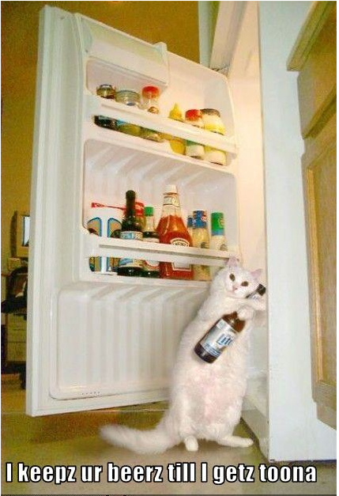
Case folding
Sec. 2.2.3
Reduce all letters to lower case
exception: upper case in mid-sentence?
e.g., General Motors
Fed vs. fed
SAIL vs. sail
Often best to lower case everything, since users will use lowercase regardless of ‘correct’ capitalization…
Google example:
Query C.A.T.
#1 result was for “cat” (well, Lolcats) not Caterpillar Inc.

Slide 24
Normalization to terms
Sec. 2.2.3
An alternative to equivalence classing is to do asymmetric expansion
An example of where this may be useful
Enter: window Search: window, windows
Enter: windows Search: Windows, windows, window
Enter: Windows Search: Windows
Potentially more powerful, but less efficient
Notes:
Why not the reverse?
24

Slide 25
Thesauri(辞典) and soundex*
Do we handle synonyms(同义词) and homonyms(同形同音异义词 )?
E.g., by hand-constructed equivalence classes
car = automobile color = colour
We can rewrite to form equivalence-class terms
When the document contains automobile, index it under car-automobile (and vice-versa)
Or we can expand a query
When the query contains automobile, look under car as well
What about spelling mistakes?
One approach is soundex(探测法，返回同音字串), which forms equivalence classes of words based on phonetic heuristics
Notes:
*Soundex (探测法，字符串的语音表示） is especially useful for Chinese since Pinyin is one of the most popular input method.

Slide 26
Stemming (词干分析)
Sec. 2.2.4
Reduce terms to their “roots” before indexing
“Stemming” suggest crude affix chopping
language dependent
e.g., automate(s), automatic, automation all reduced to automat.
for example compressed
and compression are both
accepted as equivalent to
compress.
for example compress and
compress are both accept
as equive to compress
Notes:
Here we show you so many issues about the normalization of terms is for 3 purposes:
Show the big differences of token and index term.
Provide some of the suggestions that may be useful in construction a real indexing system.
Help our students understanding the challenges of a real web search engine.

Slide 27
Lemmatization (词形还原)
Sec. 2.2.4
Reduce inflectional/variant forms to base form
E.g.,
am, are, is → be
car, cars, car's, cars' → car
the boy's cars are different colors → the boy car be different color
Lemmatization implies doing “proper” reduction to dictionary headword form

Slide 28
Document File
The documents file stores the documents that are being indexed. The documents may be:
• primary documents, e.g., electronic journal articles
• surrogates (文档替代品), e.g., catalog records(目录) or abstracts(摘要)

Slide 29
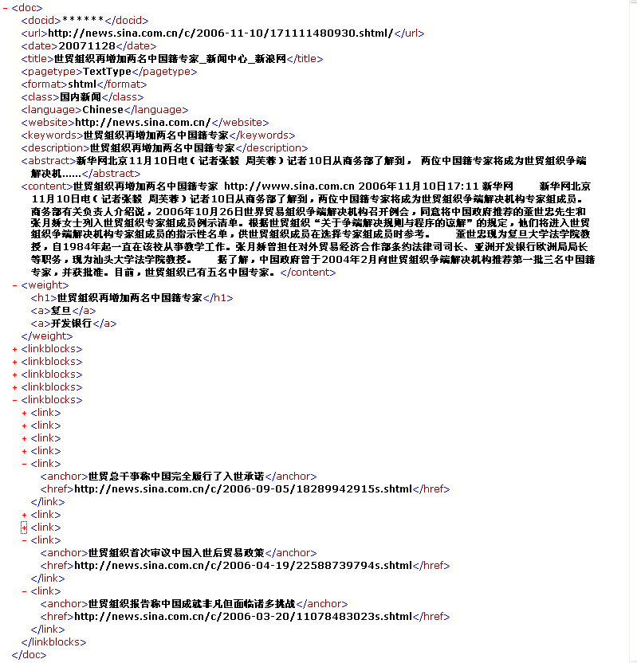
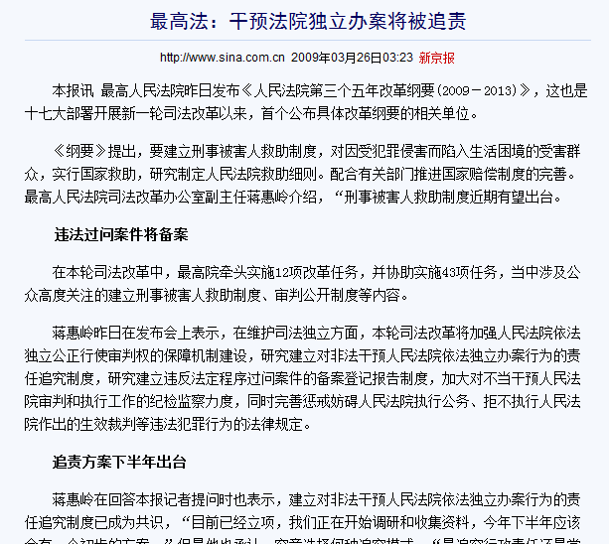
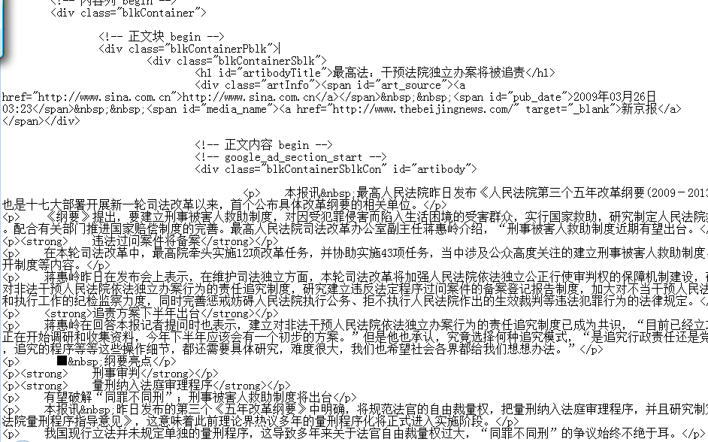
Docs file for web search system (Example of docs)
A possible representation for purified web pages
a document presented to users by IE
A spider view for the web page

Slide 30
Postings File
The postings file stores the elements of a sparse matrix(稀疏矩阵), the term assignment matrix.
It is stored as a separate inverted list for each column, i.e., a list corresponding to each term in the index file.
Each element in an inverted list is called a posting (记录), i.e., the occurrence on a term in a document
Each list consists of one or many individual postings.
Notes:
取bool模型二维表中的行向量，只取1的点作为posting file 中的atom项

Slide 31
Postings File: A Linked List for Each Term
1 abacus
3 94
19 7
19 212
22 56
2 actor
66
19 213
29 45
3 aspen(白杨)
5 43
4 atoll
3
70
34 40
A linked list for each term is convenient to process sequentially, but slow to update when the lists are long.
Document ID
Location Pointer

Slide 32
Data for Calculating Term Weights
The calculation of term weights requires extra data to be held in the inverted file system.
For each term, t_{j} and document, d_{i}
f_{ij} number of occurrences of t_{j} in d_{i}
For each term, t_{j}
n_{j} number of documents containing t_{j}
For each document, d_{i}
m_{i} maximum frequency of any term in d_{i}
For the entire document file
n total number of documents

Slide 33
Index File: Individual Records for Each Term
The record for term j in the index file contains:
term j
pointer to inverted (postings) list for term j
number of documents in which term j occurs (n_{j})

Slide 34

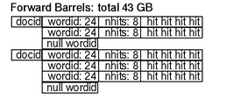

Inverted Files: Google’s Example
Ref: Sergey Brin and Lawrence Page, The Anatomy of a Large-Scale Hypertextual Web Search Engine, 1998
It’s the earliest version of Google (before 1998)
For plain text: font size is represented relative to the rest of the document using 3 bits

Slide 35
Length of Postings File
For a common term there may be very large numbers of postings for a given term.
Example:
1,000,000,000 documents
1,000,000 distinct words
average length 1,000 words per document
How many postings we may get?
10¹² postings

Slide 36
Postings File
Merging inverted lists is the most computationally intensive task in many information retrieval systems.
Since inverted lists may be long, it is important to match postings efficiently.
Usually, the inverted lists will be held on disk and paged into memory for matching. Therefore algorithms for matching postings process the lists sequentially.
For efficient matching, the inverted lists should all be sorted in the same sequence.
Inverted lists are commonly cached to minimize disk accesses.
Notes:
The second homework could be the survey for index merging.

Slide 37
Structure of Index File

Slide 38
Index File Structures: Linear Index
Advantages
Can be searched quickly, e.g., by binary search, O(log n)
Good for lexicographic processing, e.g., comp*
Convenient for batch updating
Economical use of storage
Disadvantages
Index must be rebuilt if an extra term is added

Slide 39
Index File Structures: Binary Tree
Input: elk, hog, bee, fox, cat, gnu, ant, dog
elk
bee
hog
ant
cat
fox
dog
gnu

Slide 40
Binary Tree
Advantages
Can be searched quickly
Convenient for batch updating
Easy to add an extra term
Economical use of storage
Disadvantages
Less good for lexicographic processing, e.g., comp*
Tree tends to become unbalanced
If the index is held on disk, important to optimize
the number of disk accesses

Slide 41
Binary Tree
Calculation of maximum depth of tree.
Illustrates importance of balanced trees.
Worst case: depth = n
O(n)
Ideal case (Balanced tree): depth = log(n + 1)/log 2
O(log n)

Slide 42
Right Threaded Binary Tree （右索二叉树）
Threaded tree:
A binary search tree in which each node uses an otherwise-empty left child link to refer to the node‘s in-order predecessor (前导节点) and an empty right child link to refer to its in-order successor(后续节点).
Right-threaded tree:
A variant of a threaded tree in which only the right thread, i.e. link to the successor, of each node is maintained. Can be used for lexicographic processing.
A good data structure when index held in memory
Knuth vol 1, 2.3.1, page 325.

Slide 43
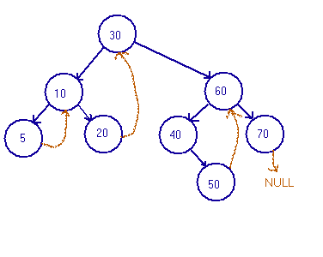
Right Threaded Binary Tree
From: Robert F. Rossa

Slide 44
B-trees
B-tree of order m:
A balanced, multiway search tree (均衡、多道搜索树):
Each node stores many keys
Root has between 1 and 2m keys.
All other internal nodes have between m and 2m keys.
If k_{i} is the i^{th} key in a given internal node, then
-> all keys in the (i-1)^{th} child are smaller than k_{i}
-> all keys in the i^{th} child are bigger than k_{i}
All leaves are at the same depth
Notes:
[From Wiki]
The database problem:
Time to search a sorted file
Usually, sorting and searching algorithms have been characterized by the number of comparison operations that must be performed using order notation. A binary search of a sorted table with records, for example, can be done in comparisons. If the table had 1,000,000 records, then a specific record could be located with about 20 comparisons: .
Large databases have historically been kept on disk drives. The time to read a record on a disk drive can dominate the time needed to compare keys once the record is available. The time to read a record from a disk drive involves a seek time and a rotational delay. The seek time may be 0 to 20 or more milliseconds, and the rotational delay averages about half the rotation period. For a 7200 RPM drive, the rotation period is 8.33 milliseconds. For a drive such as the Seagate ST3500320NS, the track-to-track seek time is 0.8 milliseconds and the average reading seek time is 8.5 milliseconds.[3] For simplicity, assume reading from disk takes about 10 milliseconds.
Naively, then, the time to locate one record out of a million would take 20 disk reads times 10 milliseconds per disk read, which is 0.2 seconds.
The time won't be that bad because individual records are grouped together in a disk block. A disk block might be 16 kilobytes. If each record is 160 bytes, then 100 records could be stored in each block. The disk read time above was actually for an entire block. Once the disk head is in position, one or more disk blocks can be read with little delay. With 100 records per block, the last 6 or so comparisons don't need to do any disk reads—the comparisons are all within the last disk block read.
To speed the search further, the first 13 to 14 comparisons (which each required a disk access) must be sped up.
An index speeds the search
A significant improvement can be made with an index. In the example above, initial disk reads narrowed the search range by a factor of two. That can be improved substantially by creating an auxiliary index that contains the first record in each disk block (sometimes called a sparse index). This auxiliary index would be 1% of the size of the original database, but it can be searched more quickly. Finding an entry in the auxiliary index would tell us which block to search in the main database; after searching the auxiliary index, we would have to search only that one block of the main database—at a cost of one more disk read. The index would hold 10,000 entries, so it would take at most 14 comparisons. Like the main database, the last 6 or so comparisons in the aux index would be on the same disk block. The index could be searched in about 8 disk reads, and the desired record could be accessed in 9 disk reads.
The trick of creating an auxiliary index can be repeated to make an auxiliary index to the auxiliary index. That would make an aux-aux index that would need only 100 entries and would fit in one disk block.
Instead of reading 14 disk blocks to find the desired record, we only need to read 3 blocks. Reading and searching the first (and only) block of the aux-aux index identifies the relevant block in aux-index. Reading and searching that aux-index block identifies the relevant block in the main database. Instead of 150 milliseconds, we need only 30 milliseconds to get the record.
The auxiliary indices have turned the search problem from a binary search requiring roughly disk reads to one requiring only disk reads where is the blocking factor (the number of entries per block: entries per block; reads).
In practice, if the main database is being frequently searched, the aux-aux index and much of the aux index may reside in a disk cache, so they would not incur a disk read.
In particular, a B-tree:
keeps keys in sorted order for sequential traversing
uses a hierarchical index to minimize the number of disk reads
uses partially full blocks to speed insertions and deletions
keeps the index balanced with an elegant recursive algorithm
In addition, a B-tree minimizes waste by making sure the interior nodes are at least half full. A B-tree can handle an arbitrary number of insertions and deletions.

Slide 45
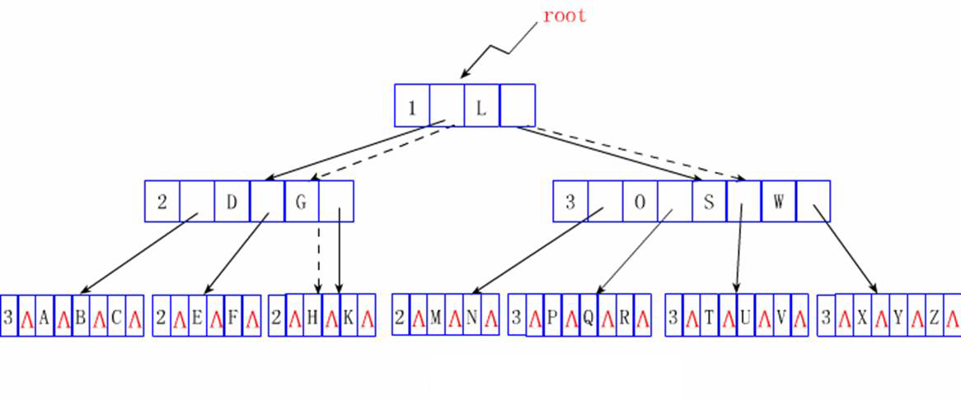
B-trees
B-tree example (order 2)
Every arrow points to a node containing between 2 and 4 keys.
A node with k keys has k + 1 pointers.

Slide 46
B⁺-tree
A B-tree is used as an index
Data is stored in the leaves of the tree, known as buckets
Example: B⁺-tree of order 2, bucket size 4
50 65
10 25
55 59
70 81 90
... D₉
D₅₁ ... D₅₄
D₆₆...
D₈₁ ...

Slide 47
Tries: Search for Substring
In some information retrieval applications, any substring can be a search term.
Tries (ReTrieval) (搜索树), using suffix trees, provide lexicographical indexes for all the substrings in a document or set of documents.

Slide 48
String Matching
Find File: Find all files whose name includes the string q.
Simple algorithm: Build an inverted index of all substrings of the file names of the form *f,
Example: if the file name is foo.txt, search terms are:
foo.txt
oo.txt
o.txt
.txt
txt
xt
t
Lexicographic processing allows searching by any q.

Slide 49
Tries: Search for Substring
Concept
semi-infinite strings, or sistrings (半无限长字串 )
Each sistring has a starting position in the text, and continues to the right until it is unique.
The sistrings are stored in (the leaves of) a tree, the suffix tree. Common parts are stored only once.
Each sistring can be associated with a location within a document where the sistring occurs.
Subtrees below a certain node represent all occurrences of the substring represented by that node.
Suffix trees have a size of the same order of magnitude as the input documents.

Slide 50
Tries: Sistrings
A binary example
String: 01 100 100 010 111
Sistrings: 1 01 100 100 010 111
2 11 001 000 101 11
3 10 010 001 011 1
4 00 100 010 111
5 01 000 101 11
6 10 001 011 1
7 00 010 111
8 00 101 11

Slide 51
Tries: Lexical Ordering
7 00 010 111
4 00 100 010 111
8 00 101 11
5 01 000 101 11
1 01 100 100 010 111
6 10 001 011 1
3 10 010 001 011 1
2 11 001 000 101 11
Unique string indicated in blue

Slide 52
Trie: Basic Concept
0
1
1
0
1
0
2
0
0
1
1
0
7
5
1
0
1
0
6
3
0
1
4
8

Slide 53
Trie: Exercise
Build the Trie of below string, the minimum length of a suffix is 6 characters(5 Minutes):
SFDSSSRTFSGEP

Slide 54
Suffix tree properties
For a string S of length n, there are n leaves and at most n internal nodes.
therefore requires only linear space
Each leaf represents a unique suffix.
Concatenation of edge labels from root to a leaf spells out the suffix.
Each internal node represents a distinct common prefix to at least two suffixes.

Slide 55
Tries: Implementation
Double Array Trie
Theppitak Karoonboonyanan. An Implementation of Double-Array Trie.
http://linux.thai.net/~thep/datrie/datrie.html

Slide 56
Content
Brief Review of Vector Space Model
Inverted Files
* Index Models (Feature Selection) (self study)

Slide 57
Feature Selection (indexing model)
Basic Issue: Which terms should be used to index (describe) a document?
Different focus than retrieval model, but related
Sometimes seen as term weighting
Some approaches
TF·IDF
Term Discrimination model
2-Poisson model
Clumping model
Language models

Slide 58
Index models
Think for a bit
What makes a term good for indexing?
Trying to represent “key” concepts in a document
What makes an index term good for a query?

Slide 59
TF·IDF, just TF
Standard weighting approach for many IR systems
many different variations of exactly how it is calculated
TF component - the more often a term occurs in a document, the more important it is in describing that document ?

Slide 60

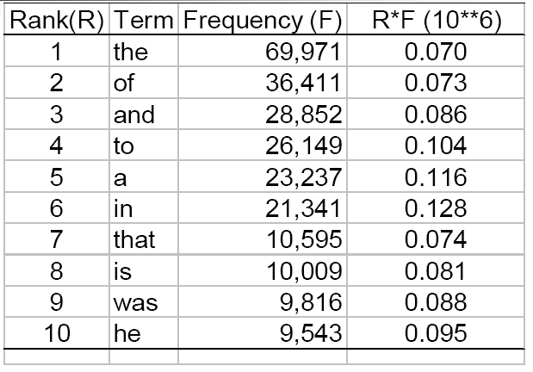
Zipf’s Law (1949) Word Frequency vs. Rank
Pro and Con
Remove stop words can greatly decrease the size of Inverted File
The most useful words are not occurred very frequently

Slide 61
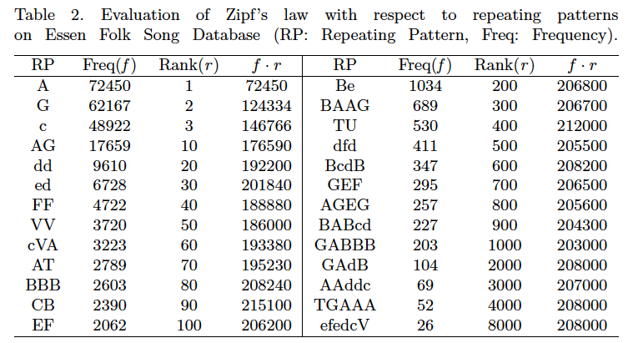
Zipf’s Law in Music (2011) XH Yang, QC Chen, XL Wang, A Dictionary Based Indexing Approach for Music Information Retrieval, IJCPL, 2011.05

Slide 62
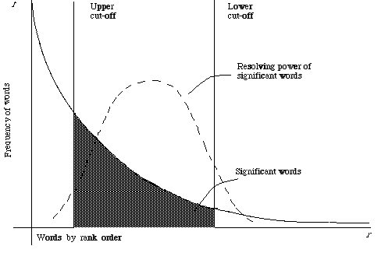
Term Frequency and Indexing Significance
Luhn: term frequency is useful for determining significance for retrieval.
from Chapter 2 of Information Retrieval, C.J. van Rijsbergen

Slide 63
A question for estimation index scale
How many terms we may get for a given scale document collection?

Slide 64

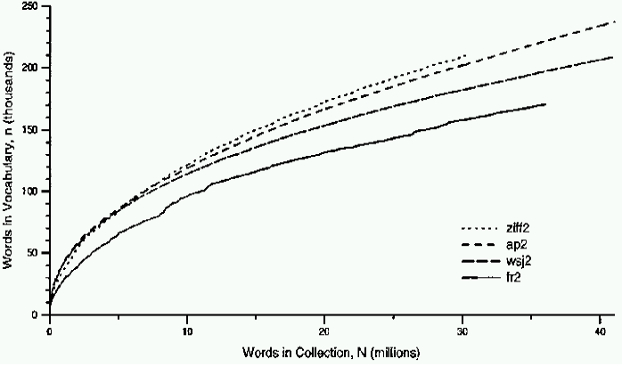
Heap’s Law Lexicon Size vs. Document Collection Size
Typical constants
K≈ 10−100
β ≈ 0.4−0.6 (approx. square-root)

Slide 65
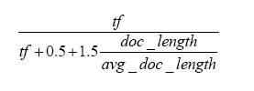
Robertson TF weight
Often called “Okapi TF”
Based on a set of simple criteria loosely connected to the 2-Poisson model¹
Basic formula is tf/(k+tf) where k is a constant (approx. 1-2)
Document length introduced as a verbosity factor (冗长因子)
same topic but more words
e.g. function used in INQUERY:
¹S.E. Robertson, S. Walker. Some simple effective approximations to the 2-Poisson model for probabilistic weighted retrieval. In Proceedings of SIGIR-94, pages 232--241, 1994.

Slide 66
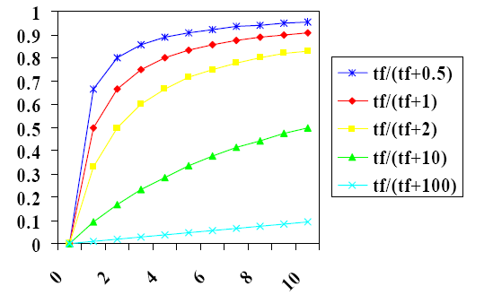
Robertson TF weight (Cont’d)

Slide 67

TF·IDF
Inverse document frequency (IDF) weight proposed by Spark Jones in 1972
This version of IDF is log (N/df) + 1
N is the number of documents in the collection, df is the number of documents the term occurs in
IDF is -log p, the entropy of a term
sometimes normalized when used in TF.IDF combination
e.g. for INQUERY:
TF and IDF are combined using multiplication
Regression has also been used to develop more complex ways of combining this information
No satisfactory model behind these combinations
Notes:
The definition of IDF is come from Information Theory, i.e., the probability of seeing a term with df as document frequency and N the number of documents in the collection should be df/N, then the information content for “See the term in document D” should be –log(df/N).
The most famous tf.idf definition for query should be BM25 (not for single term).

Slide 68
Term Discrimination Model
Proposed by Salton in 1975
Based on vector space model
documents and queries are vectors in an n-dimensional space for n terms
Compute discrimination value of a term
degree to which use of the term will help to distinguish documents
Compare average similarity of documents both with and without an index term

Slide 69
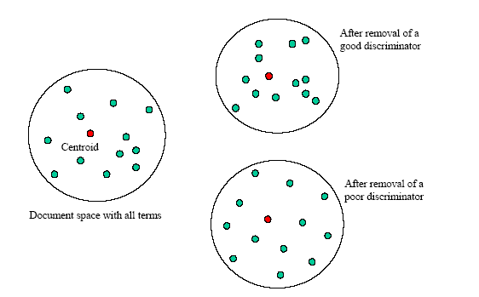
Term Discrimination Model

Slide 70


Term Discrimination Model (Cont’d)
Compute average similarity or “density” of document space
AVGSIM is the density
where K is a normalizing constant (e.g., 1/n(n-1))
similar() is a similarity function such as cosine correlation
Can be computed more efficiently using an average document or centroid
frequencies in the centroid vector are average of frequencies in document vectors

Slide 71
Term Discrimination Model (Cont’d)
Let (AVGSIM)_{k} be density with term k removed from documents
Discrimination value for term k is
DISCVALUE_{k} = (AVGSIM)_{k} - AVGSIM
Good discriminators have positive DISCVALUE_{k}
introduction of term decreases the density (moves some docs away)
tend to be medium frequency
Indifferent discriminators have DISCVALUE near zero
introduction of term has no effect
tend to be low frequency
Poor discriminators have negative DISCVALUE
introduction of term increases the density (moves all docs closer)
tend to be high frequency
Obvious criticism is that discrimination of relevant and nonrelevant documents is the important factor

Slide 72
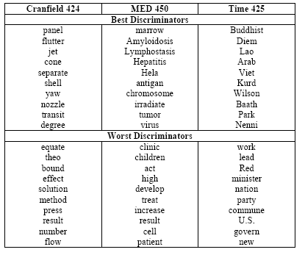
Best and Worst Discriminators for 3 Collections

Slide 73
Summary
Inverted File
Documents are indexed by term or word based posting lists
Index File structure includes linear, B-tree or Hash table. Usually B-trees are more efficient in searching.
Feature Selection
To determine the most important or representative words or terms to be applied for document indexing.
Feature selection approaches: TF, IDF and their variations
Term discrimination model can be applied to select index terms

Slide 74
Question?

